Slide 1
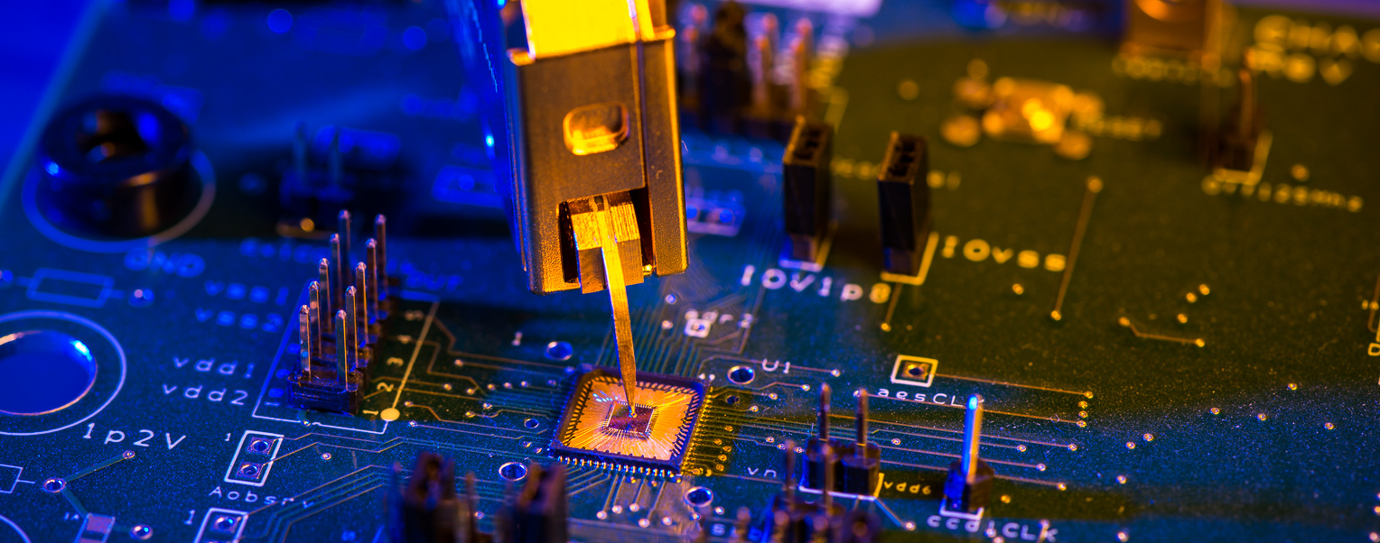
Hardware Security – Challenges and Directions
Selected Areas in Cryptography (SAC 2023)
Prof. Dr.-Ing. Tim Güneysu

Slide 2
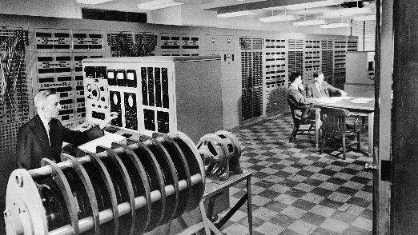
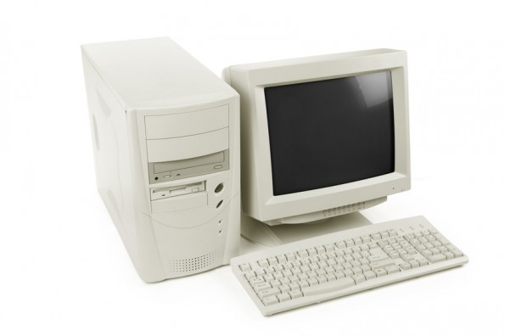


Digital Evolution and Security
>1950
>1985
>2020
Granularity
Implementation
Hardware
Software
Software
Hardware
Hardware
Security Demand
How to partition security into hardware & software?
How much security can we achieve in hardware?
Physical Exposure
Privacy Requirements
Networking & Connectivity

Slide 3





Why a Root of Trust in Hardware is Essential
Hardware implementations are more efficient
Boosts computationally exensive cryptography
Less energy/area costs for constrained applicaitons
Protections in hardware are more powerful
Opening up a hardware chip is assumed with higher cost compared to a disassembling a binary
Some advanced countermeasures are only for hardware
Security-relevant components are hardware-only
True Random Number Generators
0110001010001

Slide 4
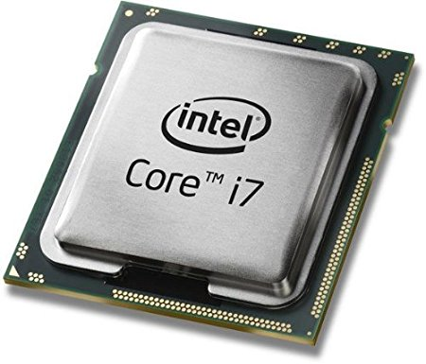
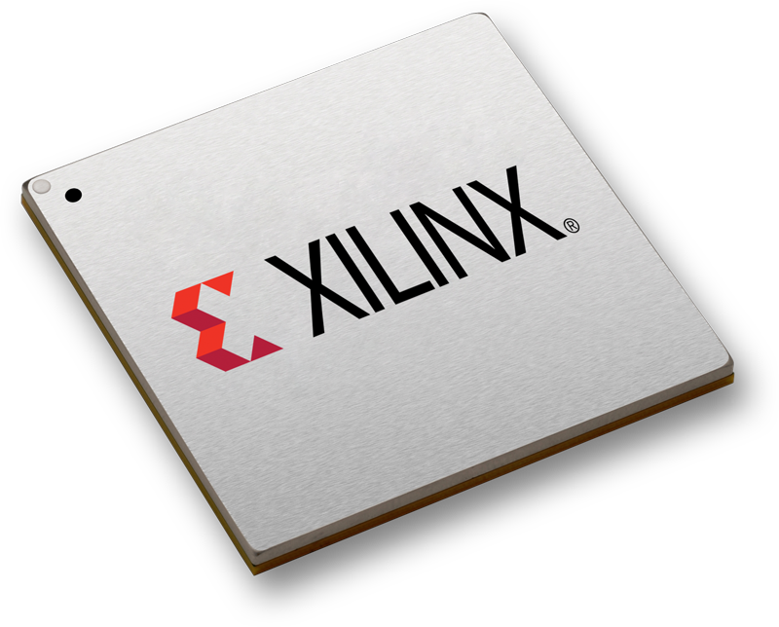
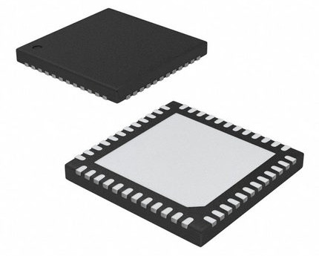








General Comparison: Software vs. Hardware (FPGA + ASIC)
Better
Power/Energy consumption
$$≫$$
$$>$$
ASIC
FPGA
$$<$$
$$≪$$
Maintainability/ Flexibility
$$<$$
$$<$$
Performance
$$≫$$
$$>$$
Development costs
Notes:
FPGA: best Trade-off (mittig und die schwächeren Vergleichszeichen sind immer zum besten hin)
Aber wie ist nun eine FPGA aufgebaut? Was macht ihn so atraktiv?

Slide 5




Hardware Root of Trust – Directions and Challenges
Challenges
#1 Knowing the Adversary
#2 Preserving your Secrets
#3 Models and Limitations in Implementation Security
Directions
#1 Moving Target Defense in Hardware
#2 New Hardware Constraints for Cryptography
#3 Trusted and Security-oriented Hardware Design

Slide 6
CHALLENGES
Knowing the Adversary

Slide 7
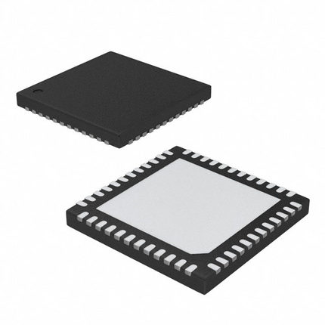
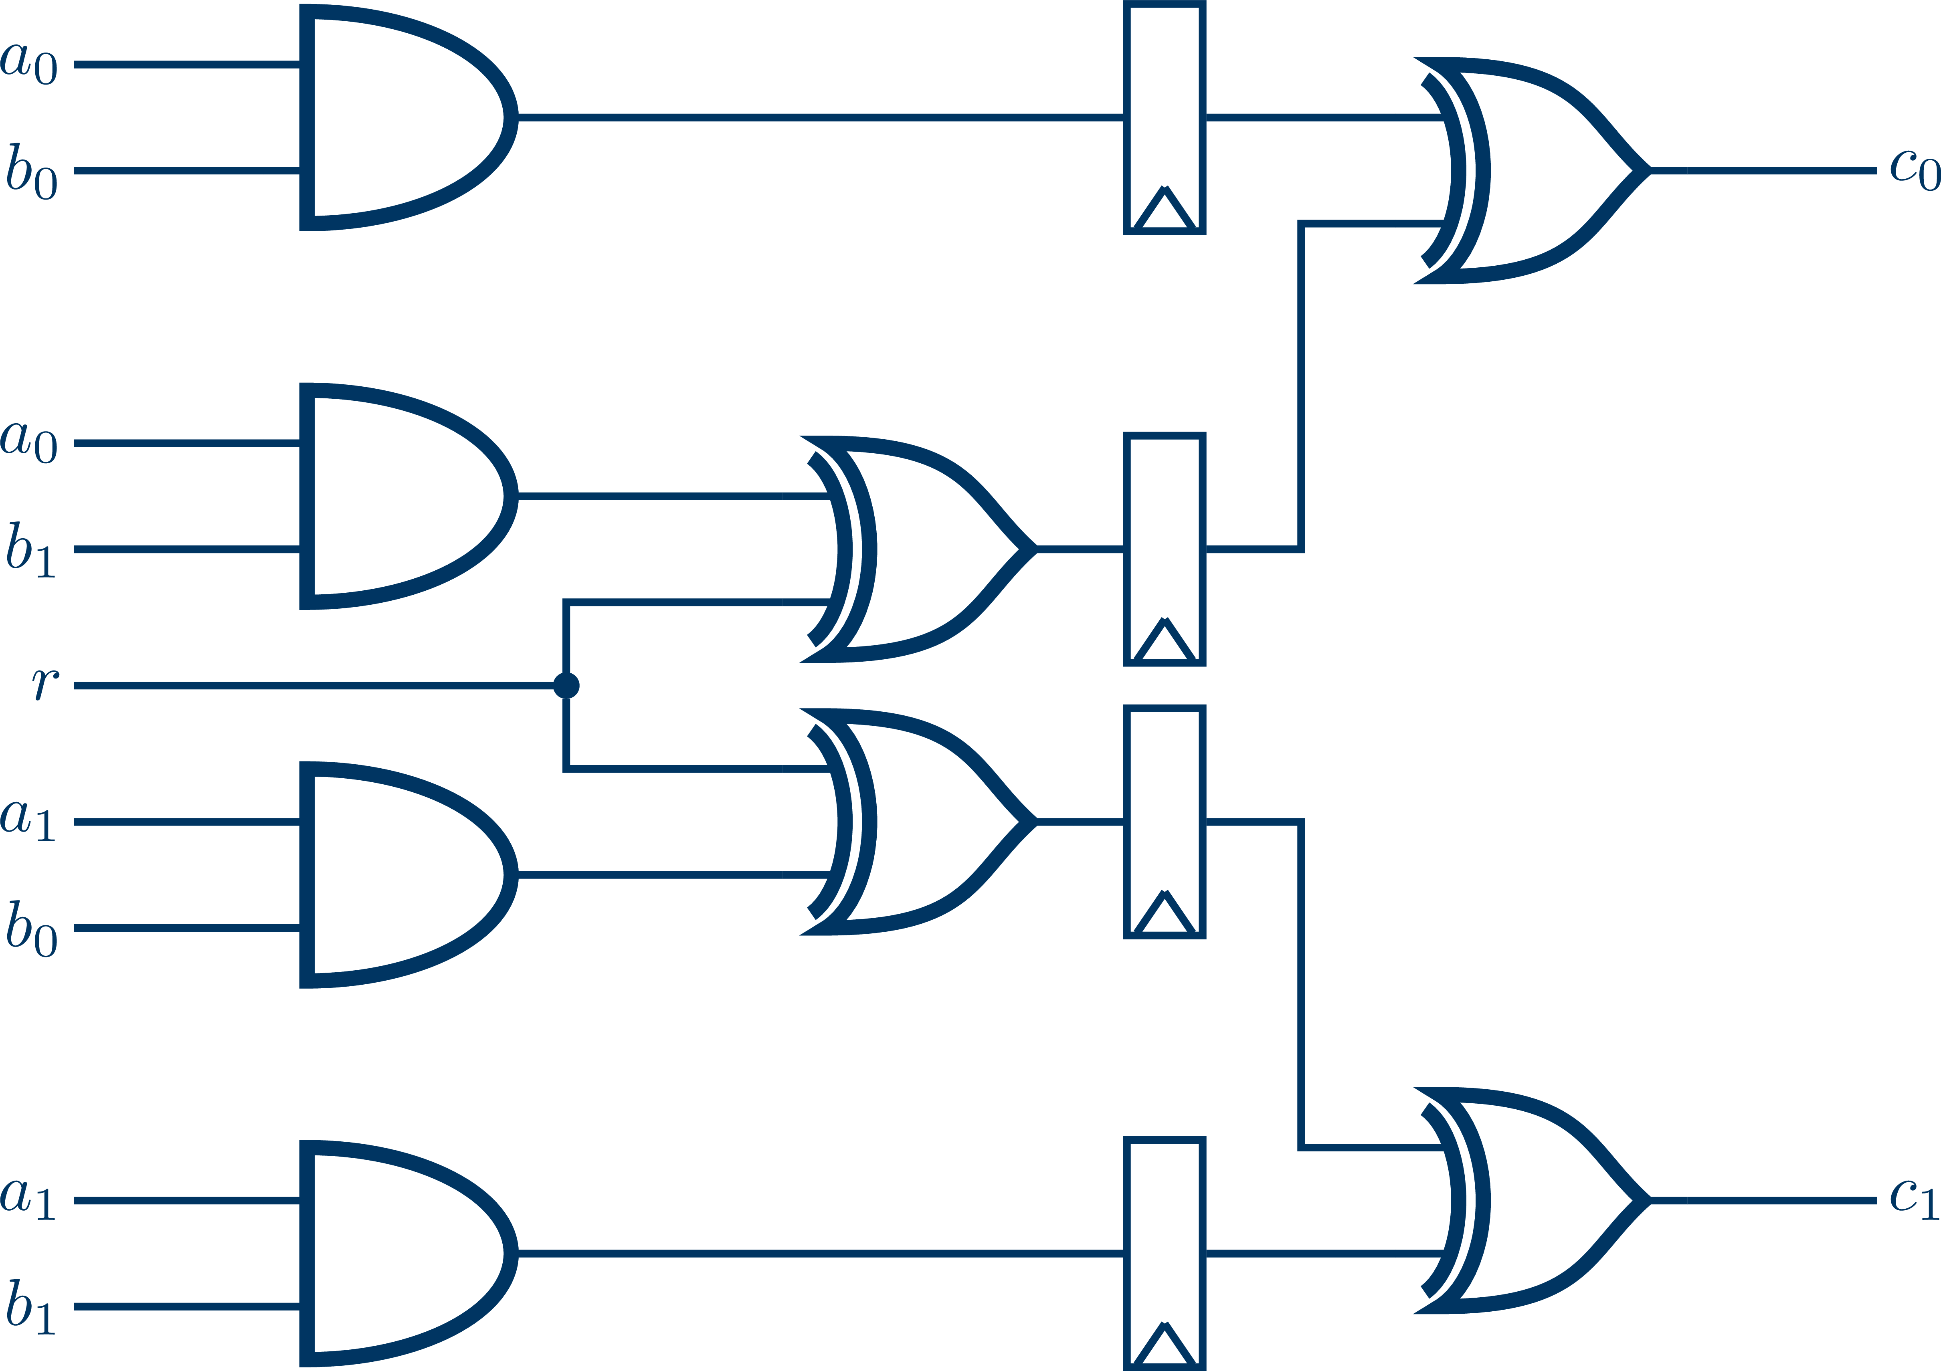


CHALLENGE #1: Knowing the Adversary – Models and Boxes
Observing & changing I/O data
Observing traffic patterns
Observing timing behavior
COMPLEXITY
y
Black-Box Attacker
Gray-Box Attacker
White-Box Attacker
x
k
k
Faulting security operations
Observing side-channel information
k
Analyzing gate-level components for vulnerabilities
Probing & modifying circuitry

Slide 8
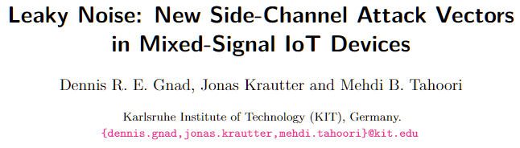
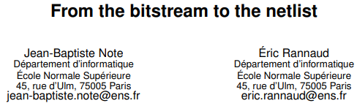
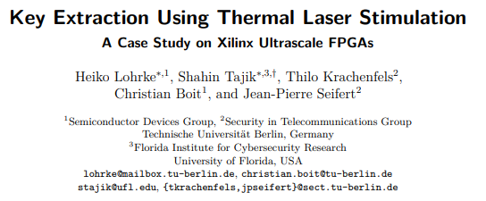
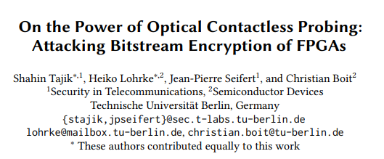
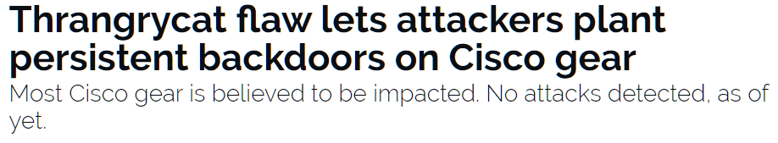
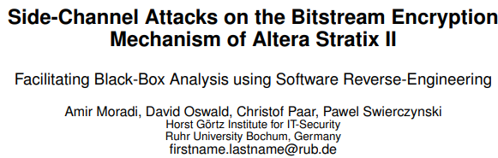
CHALLENGE #1: Knowing the Adversary – Attacks in SW and HW
Logical Run-Time Attacks
Boot attacks
Software/Memory flaws
Crypto primitive/protocol
Physical Attacks
Side-Channel analysis
Fault-Injection Attacks
Probing/Test port access
IP Attacks
Reverse engineering
Cloning & modifications
Trojans (HW & SW)
Supply chain
Software
Security Measures
Hardware
How much protection does hardware offer?

Slide 9
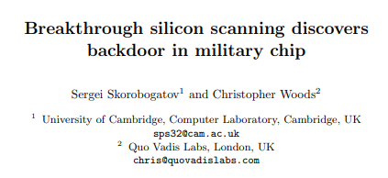


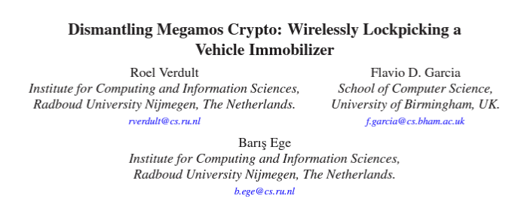

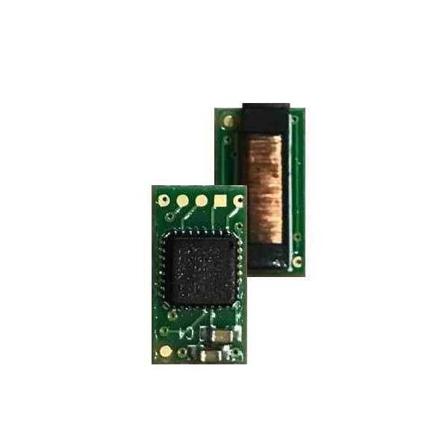

CHALLENGE #1: Knowing the Adversary – Model Mismatches
Even more prominent examples:
Real attackers do no care about adversary models or laws
(Neither the public when your system is published to be broken)
The selection of choosing a minimal but holistic set of countermeasures is an underresearched topic
Megamos

Slide 10
CHALLENGES
Preserve Your Secrets

Slide 11

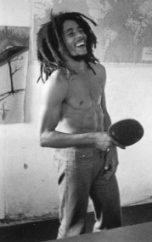

CHALLENGE #2: Preserving your Secrets
Alice
Oscar
Bob
ÜOc#2qß$Kqj
SAC_CA_2023
e
ÜOc#2qß$Kqj
Untrusted
Channel
ÜOc#2qß$Kqj
e⁻¹
SAC_CA_2023
k
k
Well-known Kerckhoff‘s Principle: only key k must be kept secret
→ Cryptographer: „Hmm, that’s basically not my problem!“
→ This needs to be solved by the implementation…

Slide 12
CHALLENGE #2: Preserving your Secrets – SW vs. HW
Options in Software
Where to put it? In the binary?
Who then protects the binary? Using obfuscation?
White-Box Cryptography (Fully broken, cf. DES, AES, DCA)
Options in Hardware
Secure distributed memories (ROM, Fuse, EEPROM, Flash, battery-backed BRAM)
Physically Unclonable Functions (PUF)
Common Approach: Put some trusted components with key storage in hardware

Slide 13
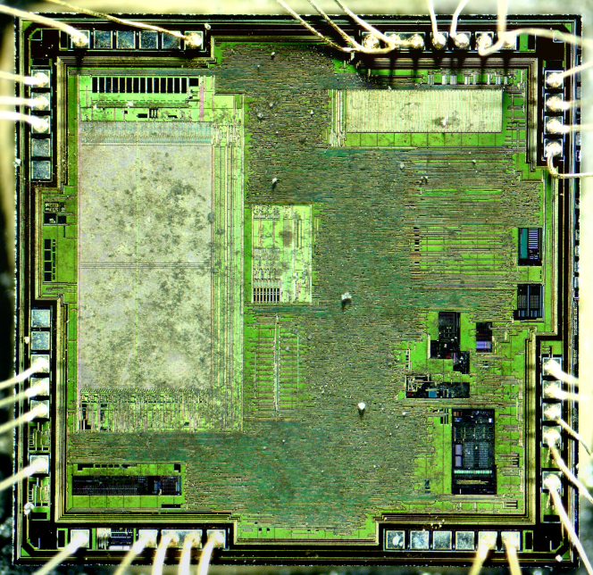
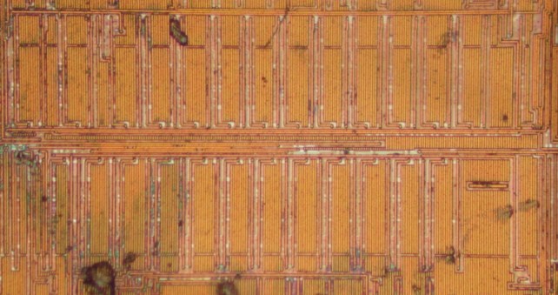
CHALLENGE #2: Preserving your Secrets – Hacking the Trusted HW
EEPROM provides a security bit to enable readout protection of
Flash memory: 0 = none
1= protected
FLASH
RAM
EEPROM
Analog
Fuses
EEPROM security fuses as implemented inside a PIC16F886 microcontroller

Slide 14
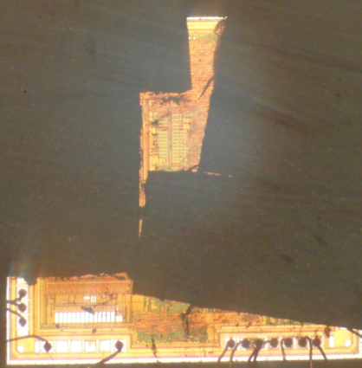
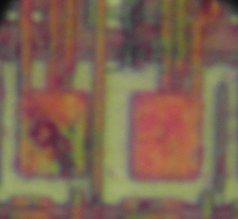
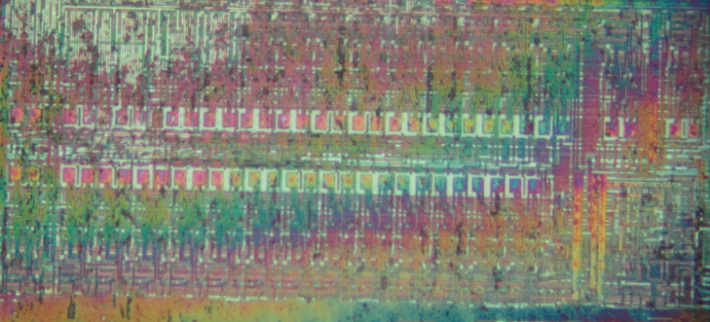
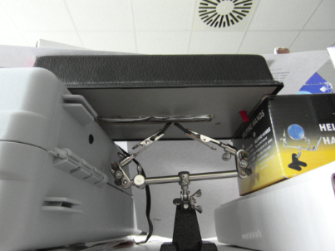
CHALLENGE #2: Preserving your Secrets – Hacking the Trusted HW
Single EEPROM-cell covered with metal plate
UV-light Erasing Device

Slide 15
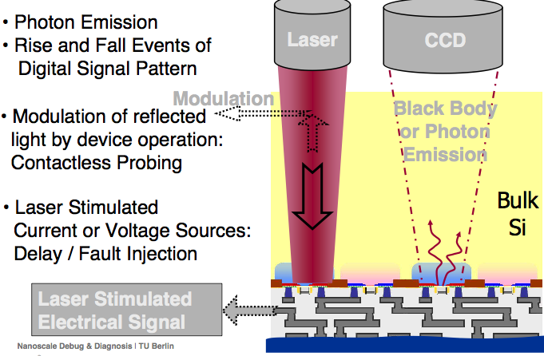
CHALLENGE #2: Preserving your Secrets – Optical Side-Channels
Access to the surface of the chip from IC backside without creating contacts with internal wires
Optical interactions with transistors using Failure Analysis (FA) tools
Optical Techniques:
Photon Emission
Laser Stimulation
Optical Probing
Boit, et al. "From IC Debug to Hardware Security Risk: The power of backside access and optical interaction," IPFA 2016.
Slide courtesy of Shahin Tajik, WPI

Slide 16
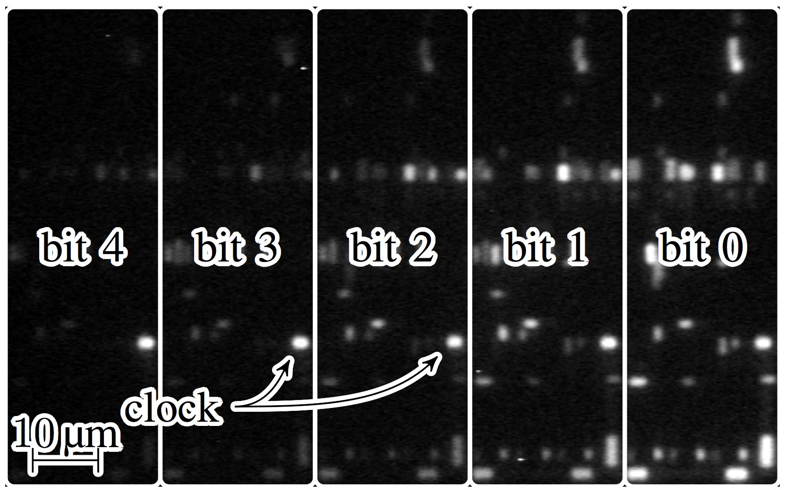
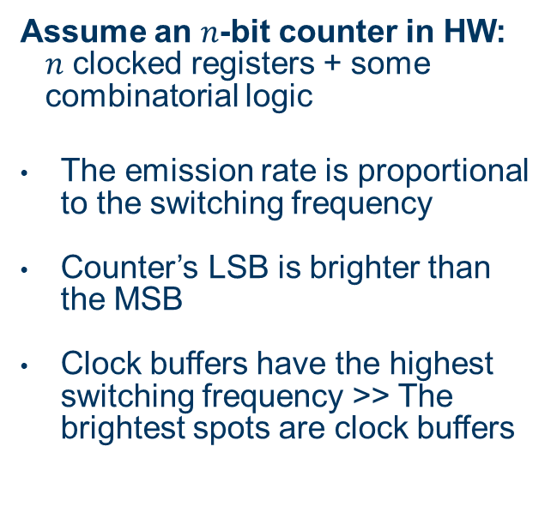
CHALLENGE #2: Preserving your Secrets – Photon Emission Example
Assume an $n$-bit counter in HW: $n$ clocked registers + some combinatorial logic
The emission rate is proportional to the switching frequency
Counter’s LSB is brighter than the MSB
Clock buffers have the highest switching frequency >> The brightest spots are clock buffers
The emission of a counting counter on Intel/Altera MAX V (180 nm)
Tajik, et al. ”Emission Analysis of Hardware Implementations," DSD 2014.
Slide courtesy of Shahin Tajik, WPI

Slide 17
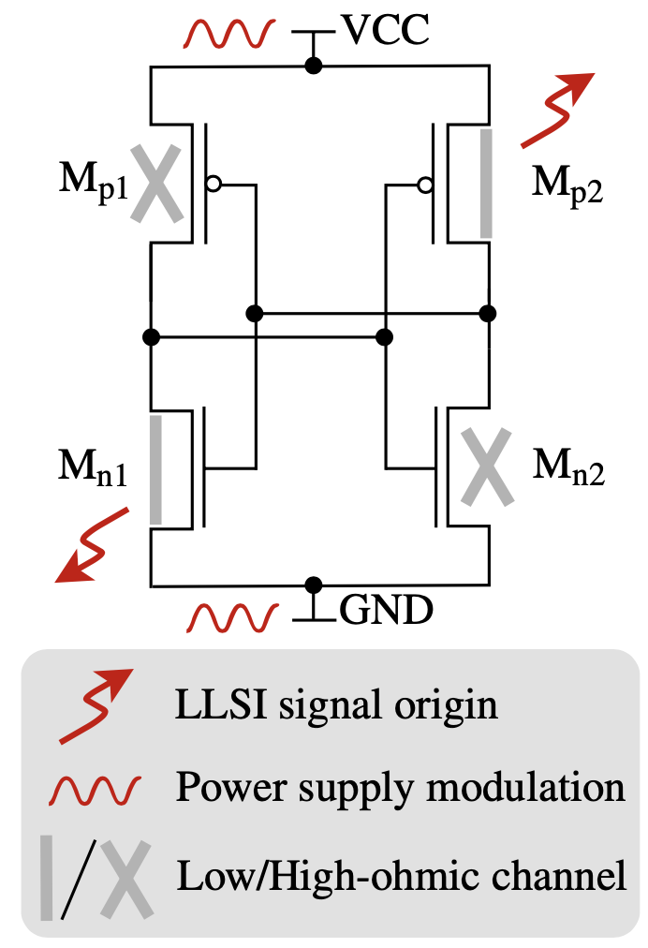
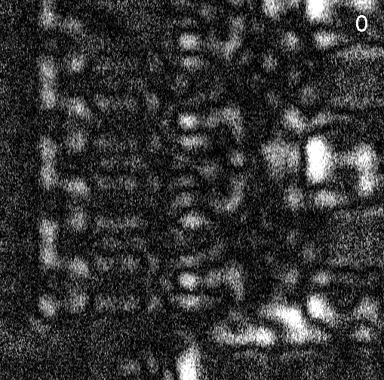
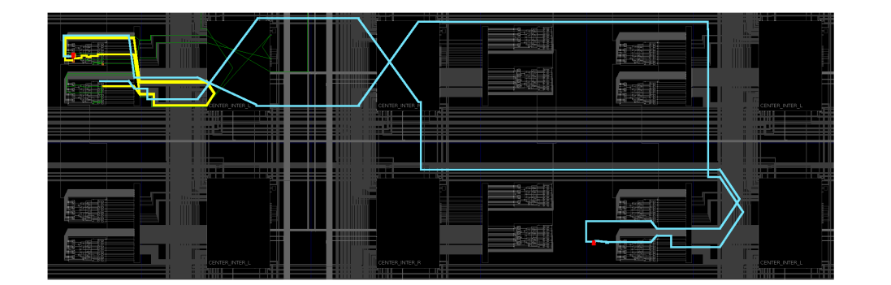
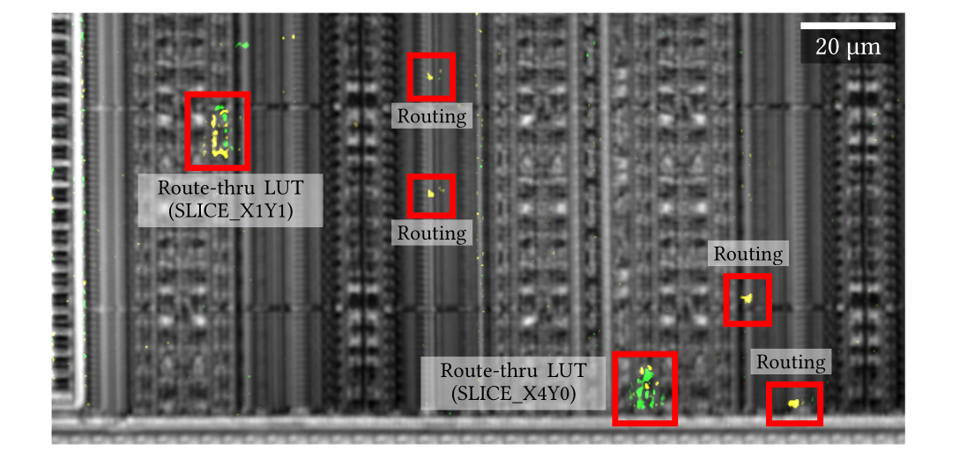
Laser Logic State Imaging (LLSI)
Intel/Altera Cyclone IV Register (60 nm)
Without any countermeasures, secrets can be extracted just as a matter of time and cost from all conventional CMOS chips.
Combinations of protections (e.g., obfuscation, PUFs,…) can help to increase the complexity beyond practicability.
Routing-based Trojan on Xilinx Kintex-7 (28 nm)
Slide courtesy of Shahin Tajik, WPI

Slide 18
CHALLENGES
Models and Limitations in Implementation Security

Slide 19




Levels of Design Abstraction – Functional Perspective
Abstraction
RAM
$$s_{0}$$
CPU
ROM
$$s_{2}$$
$$s_{1}$$
I/O
System
Algorithm
Register Transfer
Gate
Circuit
Material
Low-Level Detail
How can we this combine with our security requirements, e.g., for SCA?
Notes:
Information from: Introduction to Logic Circuits & Logic Design wiht Verilog (page 158)

Slide 20

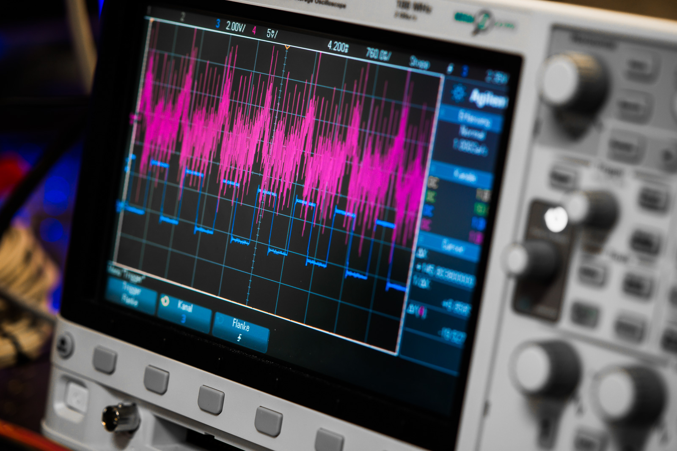
Side-Channel Attacks in Practice
Cryptographic Operation
(Statistical) analysis to recover processed secret
Measure power consumption on execution
Common Empirical Methods:
Simple Power Analysis (SPA)
Differential Power Analysis (DPA)
Correlation Power Analysis (CPA)
Test Vector Leakage Assessment (TVLA)

Slide 21
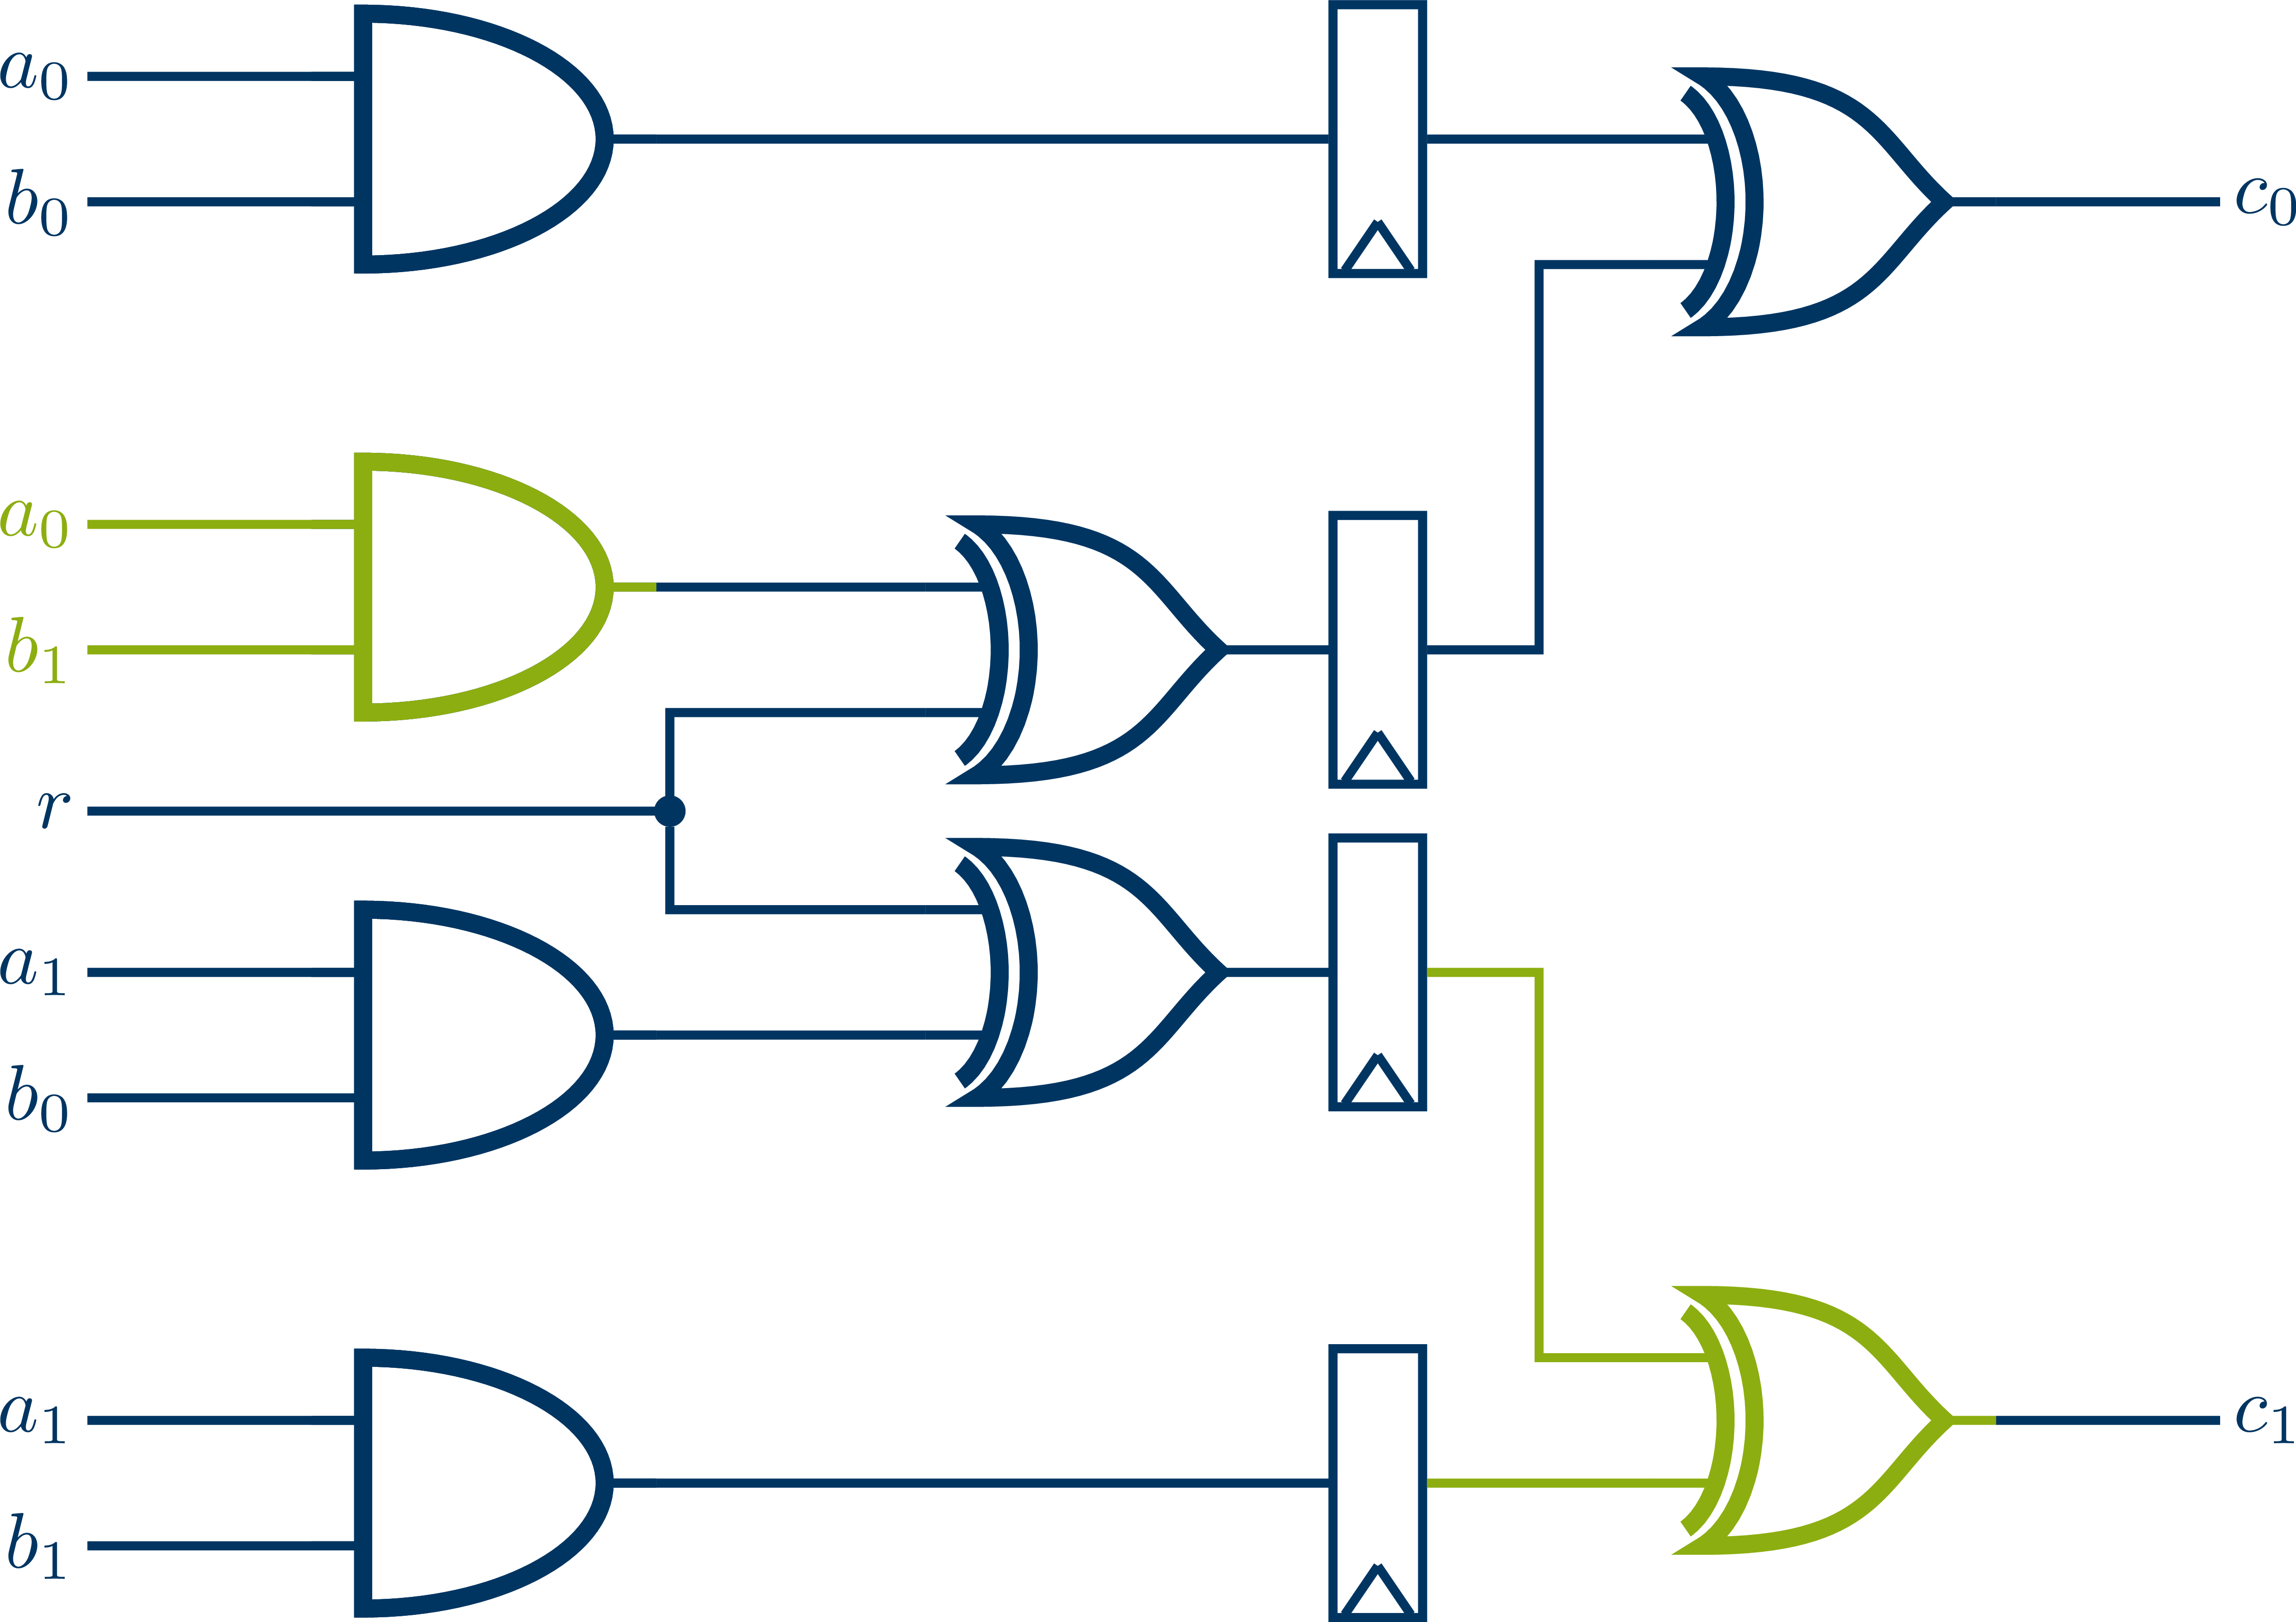
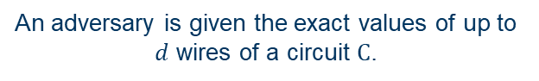

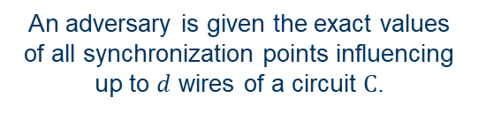
Modeling Side-Channel Attacks
$d$-probing model [ISW03]
Glitch-extended $d$-probing model [FGP+18]
An adversary is given the exact values of up to $d$ wires of a circuit $C$.
An adversary is given the exact values of all synchronization points influencing up to $d$ wires of a circuit $C$.

Slide 22








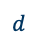

Advanced Models – Protection by Secure Gadgets
Insecure Circuit
Protected Circuit
$$s$$
$$a$$
$$a$$
$$s$$
$$b$$
$$b$$
$$s$$
$$x$$
$$x$$
$$s$$
$$c$$
$$c$$
$$s$$
$$d$$
$$d$$
Replace insecure gates by secure gadgets
Share inputs and outputs
Maintain timing (pipelining)

Slide 23

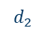

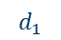
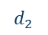
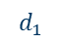
Modeling Side-Channel Attacks – Composability
PNI [BBD+15]
Probe Non-Interference
PSNI [BBD+16]
Probe Strong Non-Interference
PINI [CS20]
Probe-Isolating Non-Interference
$$d_{1}$$
$$d_{1}$$
$$d_{2}$$
$$d_{2}$$
$$d^{′}≤d$$
$$d_{1}+d_{2}≤d$$
$$d_{1}+d_{2}≤d$$
Similiar notions for fault injection attacks and the combined setting: FINI, CINI [FRSG22]

Slide 24
Levels of Design Abstraction and SCA – The Security Gap
Formal
Verification
Constant
Time
ISW, PNI, PSNI, PINI
FINI, CINI
???
THE GAP
Abstraction
Suitable complexity-aware sub-gate-level modelling is required for holistic verificaiton of implementation security
With a holistic view, root-cause analysis becomes feasible
RAM
$$s_{0}$$
CPU
ROM
$$s_{2}$$
$$s_{1}$$
I/O
System
Algorithm
Register Transfer
Gate
Circuit
Material
Low-Level Detail
SPA DPA
CPA
TVLA
???
Testing and Practical Validation
Notes:
Information from: Introduction to Logic Circuits & Logic Design wiht Verilog (page 158)

Slide 25
DIRECTIONS
Moving Target Defense in Hardware

Slide 26
DIRECTION: Moving Target Defense in Hardware
Many attack vectors exploit the static nature of hardware
Idea: Runtime reconfiguration of HW security components
Advantages:
Profiled and location-based attacks could be eliminated, e.g. SCA
Hardware could be upgraded on-the-fly in case of security failures
Runtime support for complex crypto portfolios (cf. NIST PQC standards)
Proof-of-Concept: Runtime-Dynamic AES Implementation on Hardware (FPGA)
Software
Secure
Hardware

Slide 27
Proof-of-Concept Architecture – Runtime Reconfiguration of AES
FPGAs can be reconfigured in parts
Partial reconfiguration requires prebuilt subconfigurations (e.g. AES rounds)
All configuration data is stored on external flash and loaded by the PRC
Xilinx ZYNQ UltraScale+ SOC
AES Variations
PRC + ICAP
Partial Reconfiguration
200 MHz

Slide 28
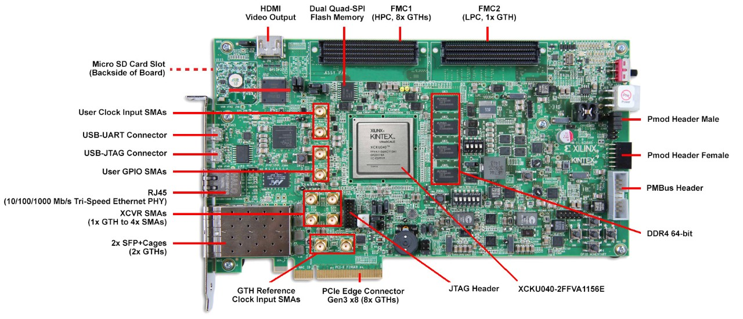
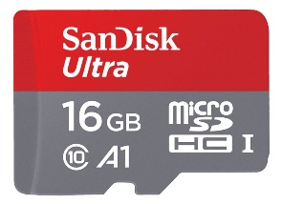
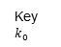
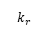
Proof-of-Concept Architecture – Design Concept – Top View
Host
UART/PCIe
Ciphertext
Plaintext
Key $k_{0}$
PRNG
Protected
AES
Encryption
Key Scheduler
$$k_{r}$$
Partial Bitstreams
FSM
ICAPe3
XCKU040-2FFVA1156E
530 000 Logic Cells • 21.1 Mb BRAM

Slide 29
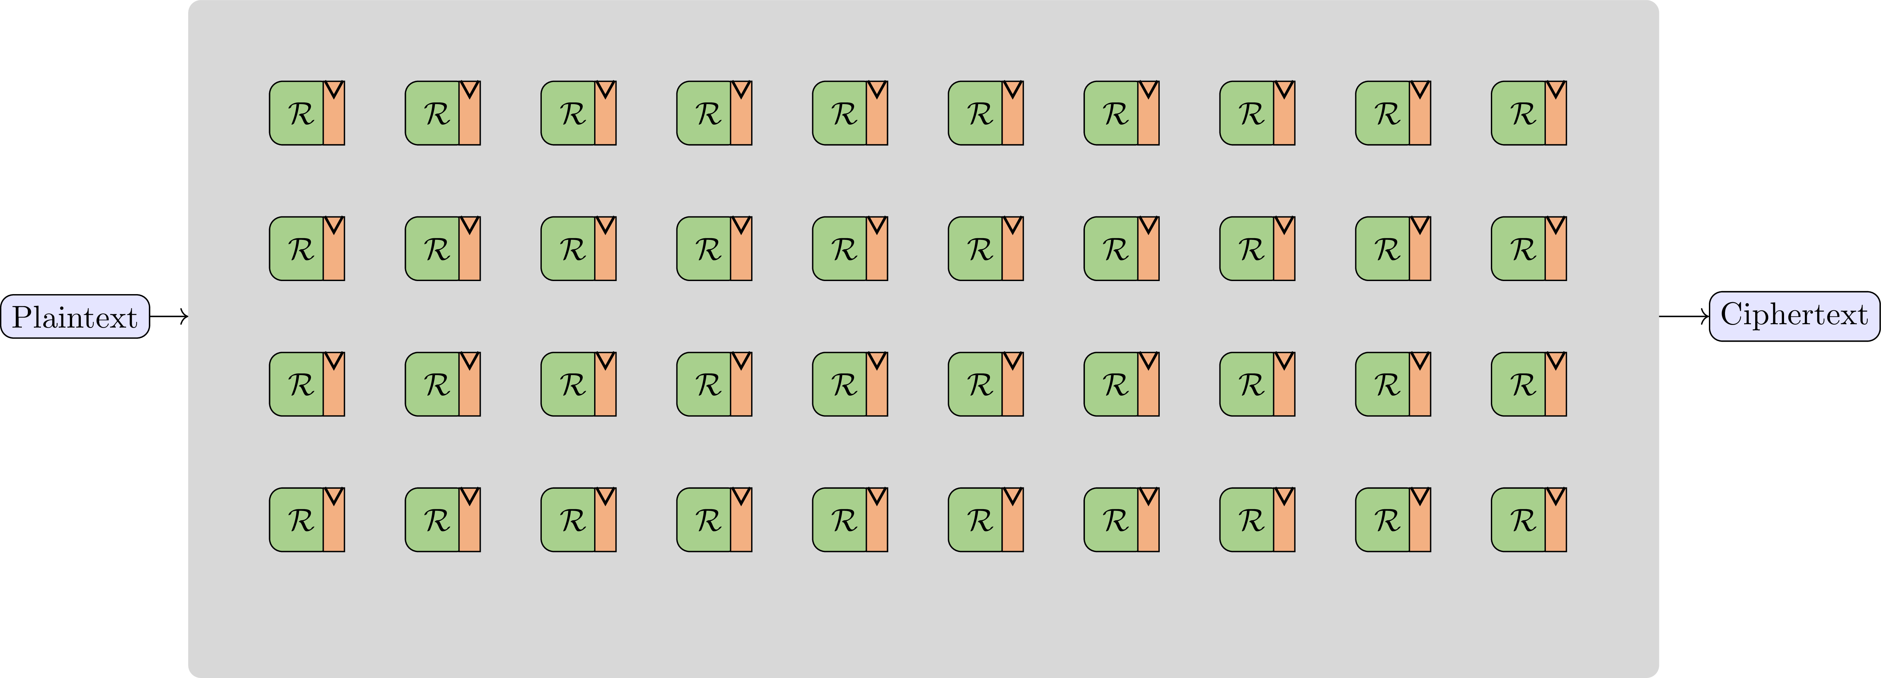
Proof-of-Concept Architecture – Protected AES Encryption
40 differently implemented AES rounds • Arranged in a $4×10$ grid • Each column represents one AES round

Slide 30
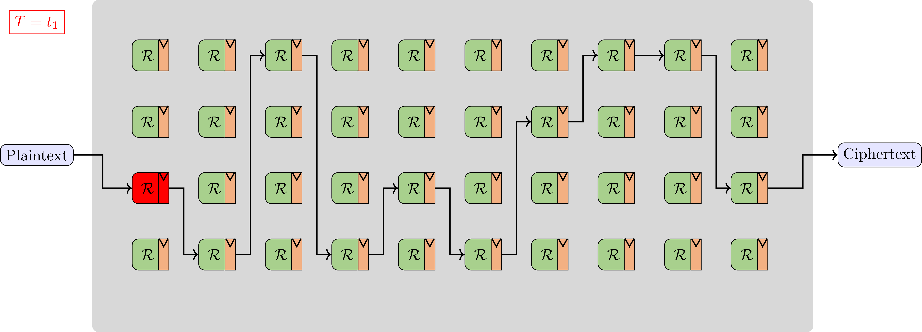
Proof-of-Concept Architecture – Protected AES Encryption

Slide 31
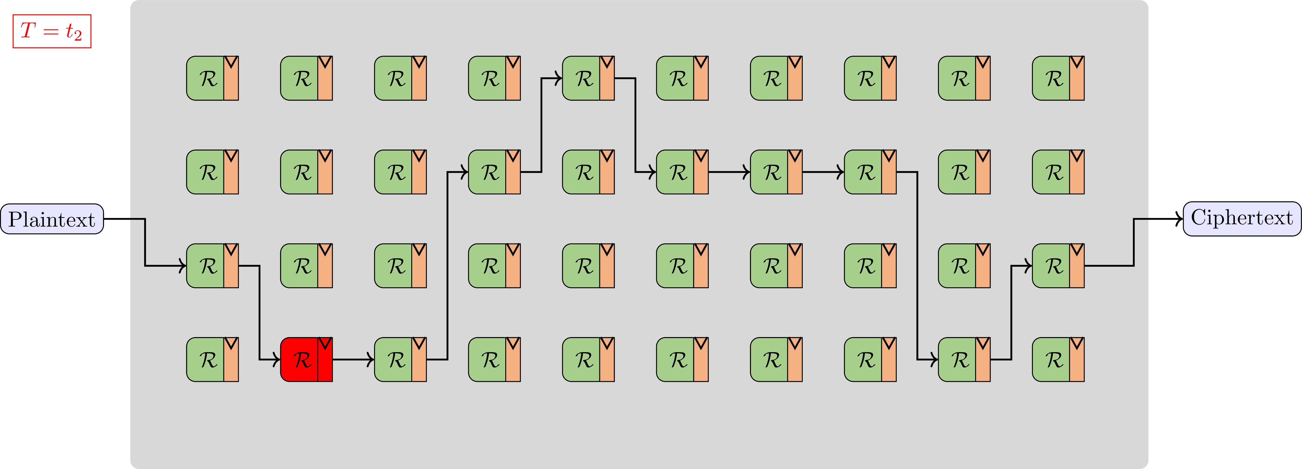
Proof-of-Concept Architecture – Protected AES Encryption

Slide 32
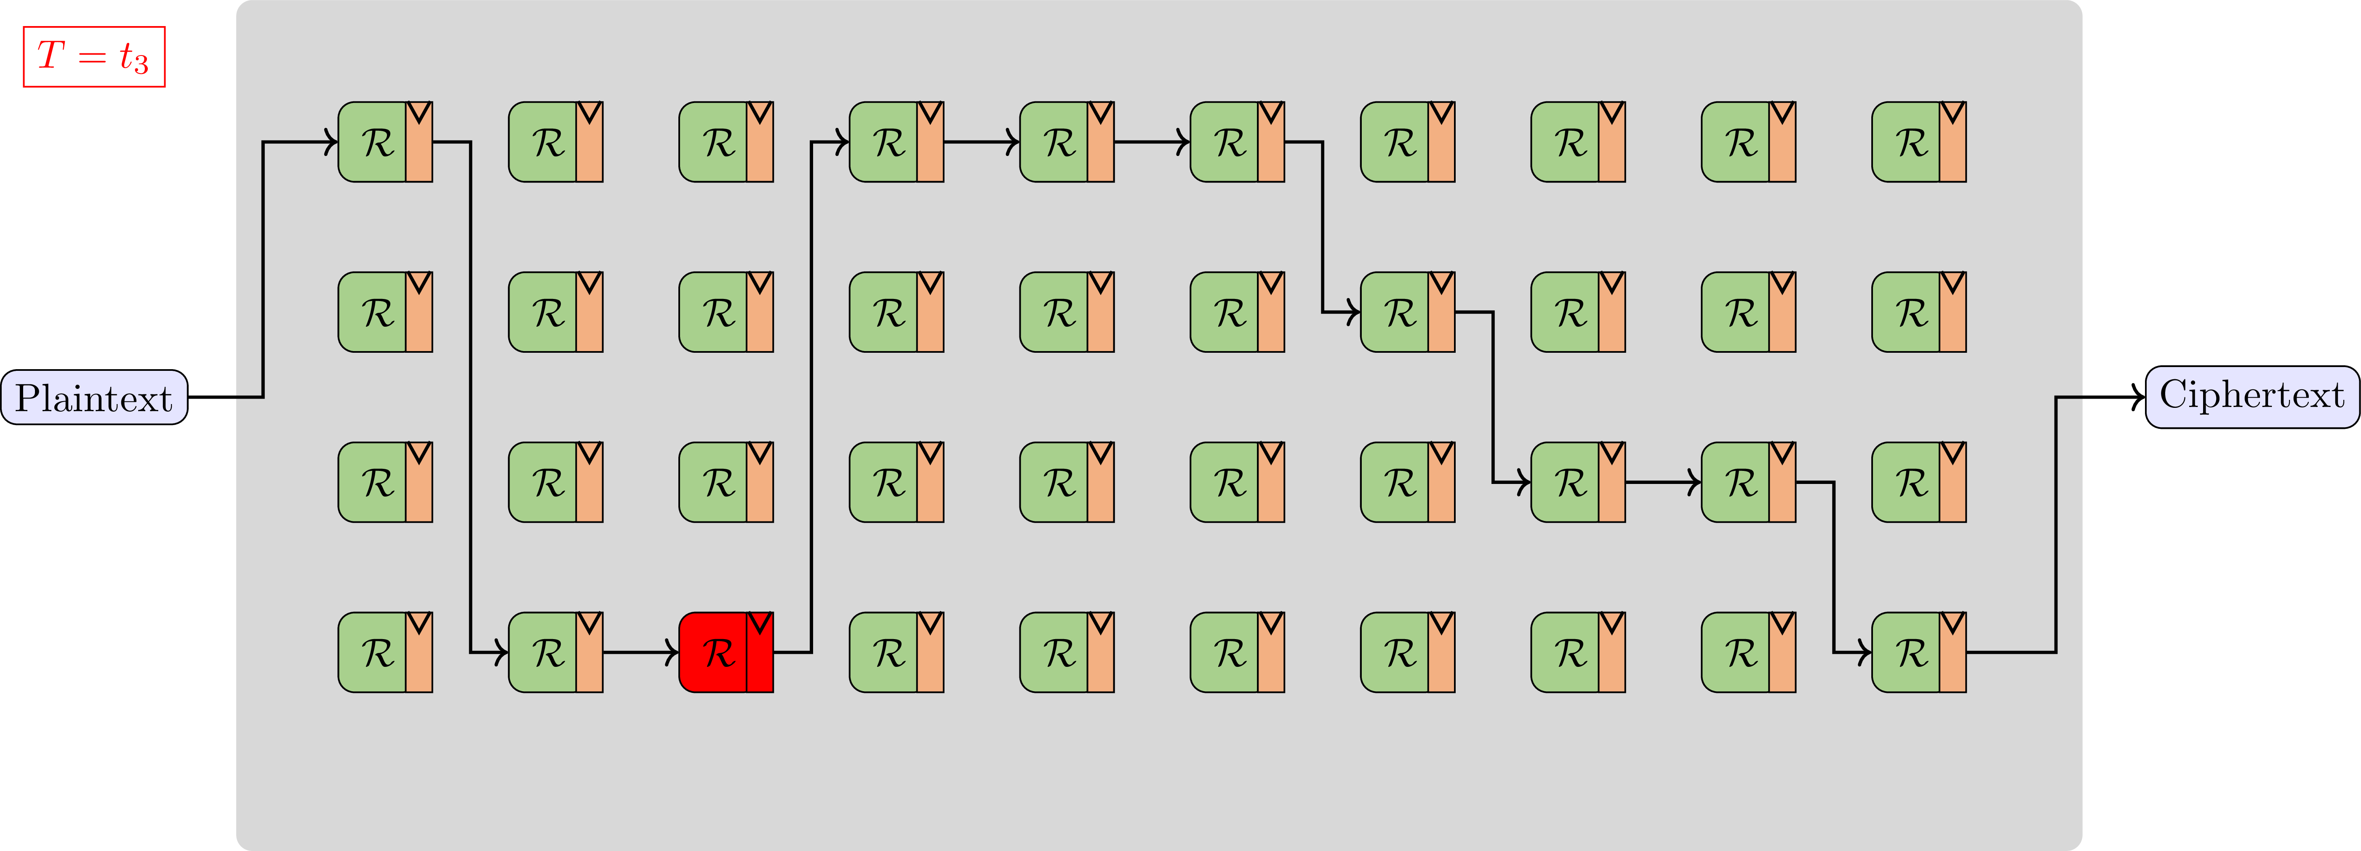
Proof-of-Concept Architecture – Protected AES Encryption

Slide 33
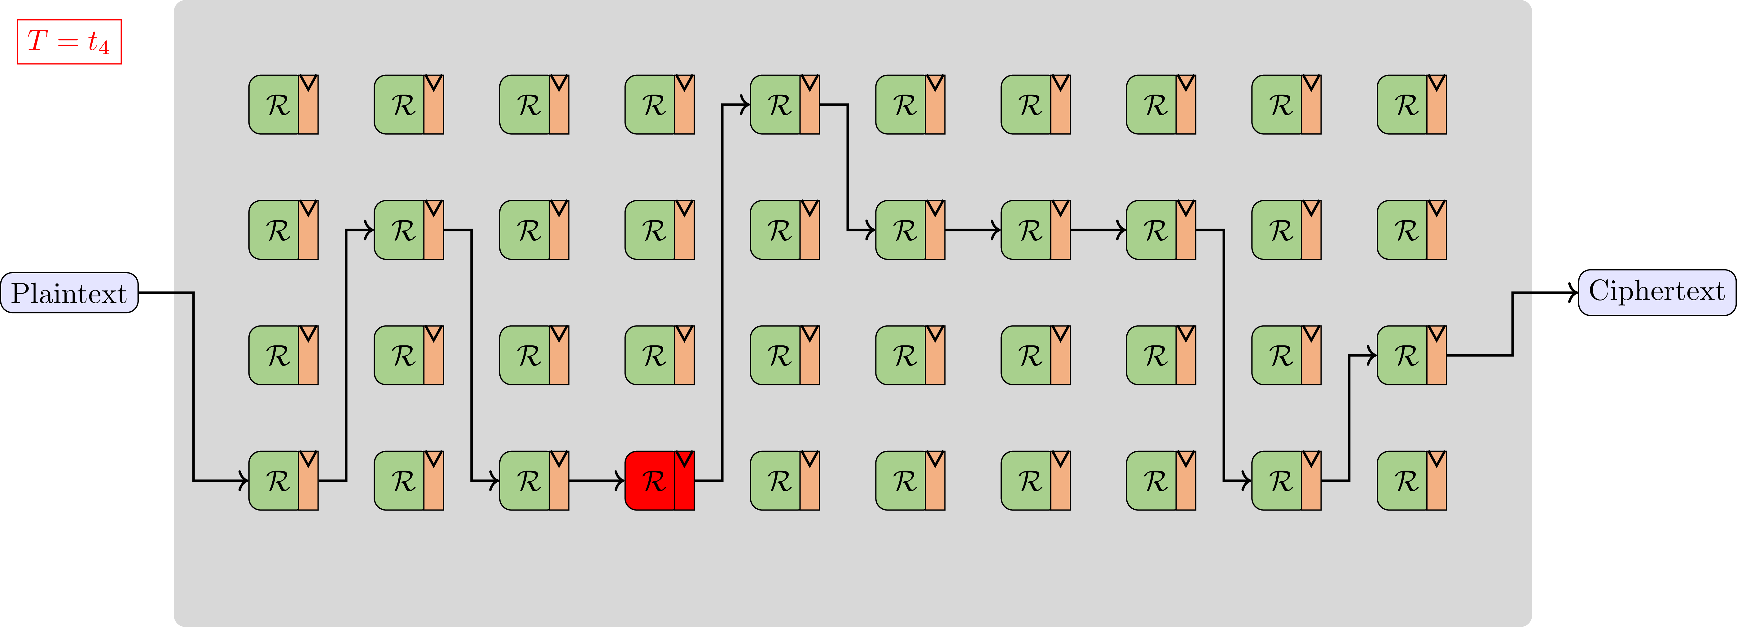
Proof-of-Concept Architecture – Protected AES Encryption

Slide 34
DIRECTION: Moving Target Defense in Hardware
Many attack vectors exploit the static nature of hardware
Idea: Runtime reconfiguration of HW security components
Disadvantages :
Limited countermeasure (x16) with high overhead in time and space
Runtime reconfiguration on FPGA is currently too slow (>10ms per run)
Formal security specification, verification and certification with dynamic hardware behavior even more complex
Future Directions:
Novel highly-reconfigurable FPGAs (as announced by Tabula but never released)
Neuromorphic computing to the rescue?
Software
Secure
Hardware

Slide 35
DIRECTIONS
New Hardware Constraints for Cryptography

Slide 36
New Hardware Constraints for Cryptography – Cache Design
Caches are set-associative structures for improving memory access times
Caches are table structure with ways and sets
Set is determined by part of the address
Way is determined by the replacement policy
Memory Address
Tag
Index
Index
Way 0
Way 1
Way 2
Way 3
0
Tag
Data
Tag
Data
Tag
Data
Tag
Data
1
Tag
Data
Tag
Data
Tag
Data
Tag
Data
2
Tag
Data
Tag
Data
Tag
Data
Tag
Data
Tag
Data
…
…
…
…
1021
Tag
Data
Tag
Data
Tag
Data
Tag
Data
1022
Tag
Data
Tag
Data
Tag
Data
Tag
Data
1023
Tag
Data
Tag
Data
Tag
Data
Tag
Data
Notes:
Animationen

Slide 37


New Hardware Constraints for Cryptography – Cache Design
Prime + Probe Attack
An attacker can observe cache accesses
Fill a cache set
Trigger victim access
Re-Access eviction set
→ Cache miss = access
There are even more sophisticated attacks
Flush & Reload Prime Prune & Probe
Memory Address
Tag
Index
Index
Way 0
Way 1
Way 2
Way 3
0
Tag
Data
Tag
Data
Tag
Data
Tag
Data
1
Tag
Data
Tag
Data
Tag
Data
Tag
Data
2
Tag
Data
Tag
Data
Tag
Data
…
…
…
…
1021
Tag
Data
Tag
Data
Tag
Data
Tag
Data
1022
Tag
Data
Tag
Data
Tag
Data
Tag
Data
1023
Tag
Data
Tag
Data
Tag
Data
Tag
Data
Notes:
Merge with previous slide

Slide 38
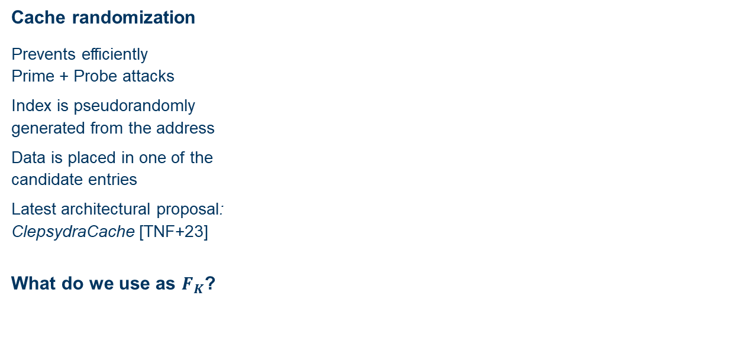

New Hardware Constraints for Cryptography – Cache Design
Cache randomization
Prevents efficiently Prime + Probe attacks
Index is pseudorandomly generated from the address
Data is placed in one of the candidate entries
Latest architectural proposal: ClepsydraCache [TNF+23]
What do we use as $F_{K}$?
Memory Address
$$F_{K}$$
Tag
Index
Index
Way 0
Way 1
Way 2
Way 3
0
Tag
Data
Tag
Data
Tag
Data
Tag
Data
1
Tag
Data
Tag
Data
Tag
Data
Tag
Data
2
Tag
Data
Tag
Data
Tag
Data
Tag
Data
Tag
Data
…
…
…
…
1021
Tag
Data
Tag
Data
Tag
Data
Tag
Data
1022
Tag
Data
Tag
Data
Tag
Data
Tag
Data
1023
Tag
Data
Tag
Data
Tag
Data
Tag
Data
[TNF+23] | Jan Philipp Thoma, Christian Niesler, Dominic A. Funke, Gregor Leander, Pierre Mayr, Nils Pohl, Lucas Davi, Tim Güneysu: ClepsydraCache - Preventing Cache Attacks with Time-Based Evictions. USENIX Security Symposium 2023
Notes:
Animationen

Slide 39



New Hardware Constraints for Cryptography – Cache Randomization
Functional Requirements
Low Latency Function will be part of cache design and must not decrease the access time
Key Dependency Secret and session-specific cache randomization
Invertibility (with a given tag) This is required to support write-back caches
Designed to match cache architectures (most recent caches have 1024 sets) Map 48-bit tag + 10-bit index to 10-bit randomized index Offset bits must be ignored
Memory Address
Tag
Index
10
48
$$F_{K}$$
10
$$F^{−1}$$
$$idx′$$
Notes:
Invertibility -> what does that mean? (figure)

Slide 40













New Hardware Constraints for Cryptography – Attacker Modell
Attacker Model is different from what we usually assume in symmetric cryptography
The attacker has never access to the output of $F_{K}$
The attacker can observe if two addresses collide
The attacker aims to find colliding addresses
$$Addr_{a}$$
$$Addr_{b}$$
$$F_{K}$$
$$F_{K}$$
$$F^{−1}$$
$$Tag_{a}$$
$$Tag_{b}$$
$$?$$
$${idx}_{a}$$
$$=$$
$${idx}_{b}$$

Slide 41










New Hardware Constraints for Cryptography – Approaches
Approach 1: Use a low-latency block cipher (e.g. 64-bit PRINCE)
Zero-pad 58-bit input and sample index-bits from ciphertext, use remainder as tag
6 Bit storage overhead for the tag and comparison logic → expensive
Approach 2: Design a 58-bit block cipher
Possible, but conventional design processes more (tag) data than required
Ignores the weaker adversary model (no output available to attacker!)
Approach 3: Design a 10-bit cipher with reduced latency ➔ SCARF [CGL+23]
$$Addr_{a}$$
$$Addr_{b}$$
$${Enc}_{K}$$
$${Enc}_{K}$$
$$F^{−1}$$
$$Tag_{a}$$
$$Tag_{b}$$
$$?$$
$${idx}_{a}$$
$$=$$
$${idx}_{b}$$
[CGL+23] | Federico Canale, Tim Güneysu, Gregor Leander, Jan Philipp Thoma, Yosuke Todo, Rei Ueno: SCARF - A Low-Latency Block Cipher for Secure Cache-Randomization. USENIX Security Symposium 2023

Slide 42




New Hardware Constraints for Cryptography – SCARF Cipher
SCARF is a 10-bit tweakable block cipher with 48-bit tweak and 240 Bit key
Latency optimized combination of SPN and Feistel structure
Designed for 7 + 1 rounds
Further cryptanalysis welcome!
Notes:
Hard part: Absorb the key in few rounds with low latency

Slide 43
DIRECTIONS
Trusted and Security-oriented Hardware Design

Slide 44
Trusted and Security-oriented Hardware Design
Abstraction
RAM
$$s_{0}$$
CPU
ROM
$$s_{2}$$
$$s_{1}$$
I/O
System
Algorithm
Register Transfer
Gate
Circuit
Material
Low-Level Detail
Hardware design EDA support optimization for performance, area and energy.
Support for security-oriented hardware design is required in EDA
Notes:
Information from: Introduction to Logic Circuits & Logic Design wiht Verilog (page 158)

Slide 45



Trusted and Security-oriented Hardware Design
Security-oriented design tool support is solely not sufficient
Trust in development tools (external verification and validation required)
Trust in manufacturing parties and supply chains
Trust in delivery services
Trust in key management and distribution services

Slide 46
CONCLUSIONS

Slide 47
Conclusions
Lessons Learned
Models of adversaries are fuzzy, better design for stronger ones
Secrets are hard to protect – hardware helps to make it harder
Models and abstractions are imperfect by nature, but often still too imperfect for implementation security
Moving target defense in hardware could disable profiling attacks
New hardware-oriented use-cases for cryptography emerge (such as fault-tolerant cryptography)
Trusted and secure design requires trusted and secure-oriented tools
47

Slide 48

Thank you!
tim.gueneysu@rub.de

Slide 49
References
[BBD+15] | Gilles Barthe, Sonia Belaïd, François Dupressoir, Pierre-Alain Fouque, Benjamin Grégoire, and Pierre-Yves Strub. Verified Proofs of Higher-Order Masking. In EUROCRYPT, pages 457–485, 2015.
[BBD+16] | Gilles Barthe, Sonia Belaïd, François Dupressoir, Pierre-Alain Fouque, Benjamin Grégoire, Pierre-Yves Strub, and Rébecca Zucchini. Strong Non-Interference and Type-Directed Higher-Order Masking. In SIGSAC, pages 116–129, 2016.
[CS20] | Gaetan Cassiers and Fran¸cois-Xavier Standaert. Trivially and Efficiently Composing Masked Gadgets With Probe Isolating Non-Interference. IEEE Trans. Inf. Forensics Secur., 15:2542–2555, 2020.
[DDE+20] | Joan Daemen, Christoph Dobraunig, Maria Eichlseder, Hannes Groß, Florian Mendel, and Robert Primas. Protecting against Statistical Ineffective Fault Attacks. IACR Trans. Cryptogr. Hardw. Embed. Syst., 2020(3):508–543, 2020.
[DN20] | Siemen Dhooghe and Svetla Nikova. My Gadget Just Cares for Me – How NINA Can Prove Security Against Combined Attacks. In CT-RSA, volume 12006 of Lecture Notes in Computer Science, pages 35–55. Springer, 2020.
[FGP+18] | Sebastian Faust, Vincent Grosso, Santos Merino Del Pozo, Clara Paglialonga, and Fran¸cois-Xavier Standaert. Composable Masking Schemes in the Presence of Physical Defaults & the Robust Probing Model. IACR Trans. Cryptogr. Hardw. Embed. Syst. , 2018(3):89–120, 2018.
[FRSG22] | Jakob Feldtkeller, Jan Richter-Brockmann, Pascal Sasdrich, and Tim Güneysu. CINI MINIS: Domain Isolation for Fault and Combined Security. CCS, 2022
[HPB21] | Vedad Hadzic, Robert Primas, and Roderick Bloem. Proving SIFA protection of masked redundant circuits. In Automated Technology for Verification and Analysis, volume 12971 of Lecture Notes in Computer Science, pages 249–265. Springer, 2021.
[ISW03] | Yuval Ishai, Amit Sahai, and David A. Wagner. Private Circuits: Securing Hardware against Probing Attacks. In Dan Boneh, editor, CRYPTO, volume 2729 of Lecture Notes in Computer Science, pages 463–481. Springer, 2003.
[TNF+23] | Jan Philipp Thoma, Christian Niesler, Dominic A. Funke, Gregor Leander, Pierre Mayr, Nils Pohl, Lucas Davi, Tim Güneysu: ClepsydraCache - Preventing Cache Attacks with Time-Based Evictions. USENIX Security Symposium 2023
[CGL+23] | Federico Canale, Tim Güneysu, Gregor Leander, Jan Philipp Thoma, Yosuke Todo, Rei Ueno: SCARF - A Low-Latency Block Cipher for Secure Cache-Randomization. USENIX Security Symposium 2023
[KSM20] | David Knichel, Pascal Sasdrich, and Amir Moradi. SILVER – Statistical Independence and Leakage Verification. In ASIACRYPT, volume 12491 of Lecture Notes in Computer Science, pages 787–816. Springer, 2020.
[RBRSS+21] | Jan Richter-Brockmann, Aein Rezaei Shahmirzadi, Pascal Sasdrich, Amir Moradi, and Tim Güneysu. FIVER – Robust Verification of Countermeasures against Fault Injections. IACR Trans. Cryptogr. Hardw. Embed. Syst., 2021(4):447–473, Aug. 2021.
[RBSG21] | Jan Richter-Brockmann, Pascal Sasdrich, and Tim Güneysu. Revisiting Fault Adversary Models - Hardware Faults in Theory and Practice. Trans. On Computers, 2022
[RFSG22] | Jan Richter-Brockmann, Jakob Feldtkeller, Pascal Sasdrich, and Tim Güneysu. VERICA - Verifi cation of Combined Attacks: Automated formal verification of security against simultaneous information leakage and tampering. IACR Trans. Cryptogr. Hardw. Embed. Syst. , 2022(4), 2022.
[SMG16] | Tobias Schneider, Amir Moradi, and Tim Güneysu. ParTI - Towards Combined Hardware Countermeasures Against Side-Channel and Fault-Injection Attacks. In CRYPTO 2016, volume 9815 of Lecture Notes in Computer Science, pages 302–332. Springer, 2016.

Slide 50
Challenges
Challenges:
Static -> Dynamic HW
Embedding of Secrets (LVP, Obfuscation)
Models and Abstraction Levels (Fuzzy adversary model (faults))
Test & Validation
Cost of Countermeasures in Combined Settings
Trust in Components and Tools

